Slide 1
Docker and docker compose

Slide 2

In Development Time
Lets say You created an Application And that's working fine in your machine

Slide 3

In Production Time
But in Production it doesn't work properly Developers experience it a lot

Slide 4
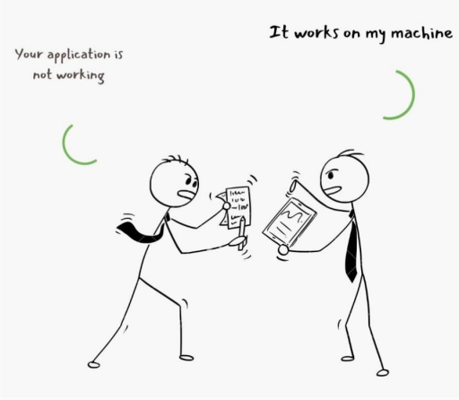
That is when the Developer's famous words are spoken

Slide 5
The Reason could be due to
Dependencies
Libraries and versions
Framework
OS Level features
Microservices
That the developers machine has but not there in the production environment

Slide 6
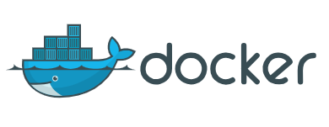
We need a standardized way to package the application with its dependencies and deploy it on any environment.
Docker is a tool designed to make it easier to create, deploy, and run applications by using containers.

Slide 7
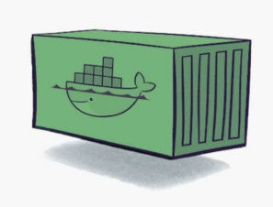
How does docker work?
Docker packages an application and all its dependencies in a virtual container that can run on any Linux server.

Slide 8
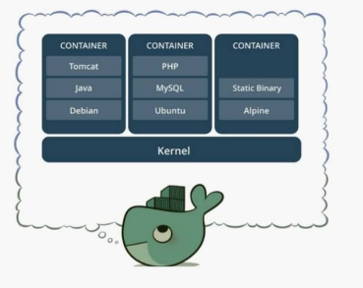
Each container runs as an isolated process in the user space and take up less space than regular VMs due to their layered architecture.

Slide 9
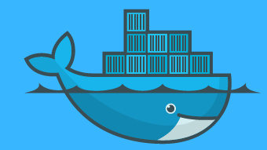
What is docker?
Docker is a software platform that allows you to build, test, and deploy applications quickly.
Docker packages software into standardized units called containers that have everything the software needs to run including libraries, system tools, code, and runtime.
Docker is used by developers to help them automate the deployment of applications inside containers.

Slide 10
Advantages of Docker
Continues Integration (CI) Efficiency -> Docker enables you to build a container image and use that same image across every step of the deployment process.
Less cost
It is light in weight
It can re-use the image
It can run on physical H/W, Virtual H/W, or on cloud.
It took very little time to create a container.

Slide 11
Disadvantages of Docker
Difficult to manage large amounts of containers
No solutions for Data recovery and backup
Docker is suitable when the development OS and testing OS are the same.
Docker does not provide cross-platform compatibility means if an application is designed to run in a docker container on Windows, then it can`t run on Linux or vice-versa

Slide 12
Why use Docker?
Consistency: Ensure applications run the same way in various environments.
Portability: Easily move applications between different machines.
Efficiency: Use resources more effectively with lightweight containers.
Ease of Deployment: Streamline deployment with standardized container images.
Isolation: Run applications independently, avoiding conflicts.
Scalability: Scale applications easily using orchestration tools.
DevOps Integration: Support for DevOps practices and CI/CD pipelines.
Version Control: Versioned images for easy tracking and rollback.
Microservices Ready: Ideal for microservices architecture, enabling modular development.
Community Support: Large community and repository for sharing containerized applications.

Slide 13
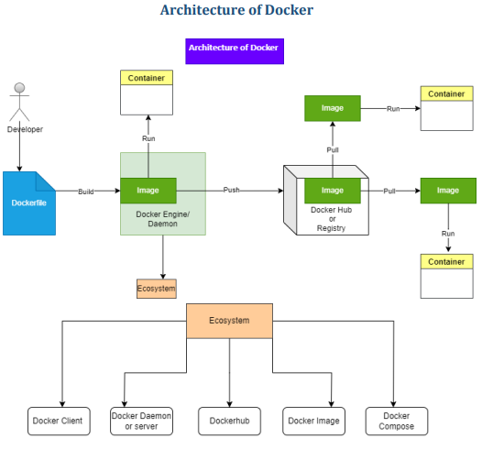
Architecture of Docker

Slide 14
Docker client
Docker users can interact with the docker daemon through a client (CLI)
The Docker client uses CLI and Rest API to communicate with the Docker daemon
When a client runs any server command on the docker client terminal, the client terminal sends these docker commands to the docker daemon
The client can communicate with more than one daemon.

Slide 15
Docker Daemon
Docker daemon runs on the Host OS
It is responsible for running container to manage docker services
Docker daemon can communicate with other daemon

Slide 16
Docker Hub/ Registry
The Docker registry manages and stores the docker images
There are two types of registries in the docker
Public registry: is also called docker hub
Private registry: it is used to share images within the enterprise

Slide 17
Docker images
Docker image is a lightweight, standalone package that contains all the necessary components (code, runtime, libraries, and system tools) to run a software application.
. It serves as a blueprint for creating Docker containers, providing consistency and portability across different environments.
Images are created using Docker files, stored in registries like Docker Hub, and can be easily pulled, pushed, and shared.
(OR)
Docker images are the read-only binary templates used to create a docker container.

Slide 18
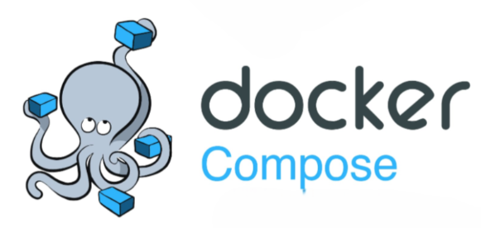
What Is Docker compose?
Docker Compose is a tool for defining and running multi-container Docker applications.
It uses a YAML file to configure the application's services, networks, and volumes, allowing for easy management of complex applications.

Slide 19
What is docker file?
A Docker file is indeed a text file containing a set of instructions. These instructions define how to build a Docker image step by step.
Docker files automate the process of creating Docker images, ensuring consistency and reproducibility in the deployment of applications.
Steps for Docker file Usage:
Create a File Named Docker file
Add Instructions in the Docker file
Build a Docker file to Create an Image
Run the Image to Create a Container

Slide 20
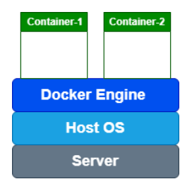
WHAT IS DOCKER CONTAINER
Docker containers are like portable, self-contained boxes for software applications.
Docker containers are like portable, self-contained boxes for software applications.
Containers are created from Docker images, acting as pre-made blueprints.
Containers provide a reliable and consistent environment for software to run.
A vital tool for ensuring software consistency in modern development and deployment.
The container itself doesn't have its own operating system.
It operates under the assumption that it has no separate
operating system.
However, yes, it does contain OS-related files inside, but
they are so minimal and lightweight that they are
considered negligible.

Slide 21
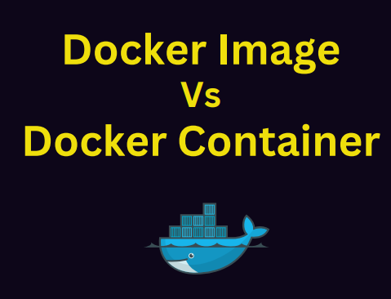

Slide 22
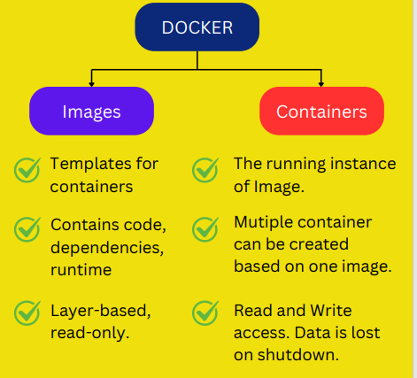
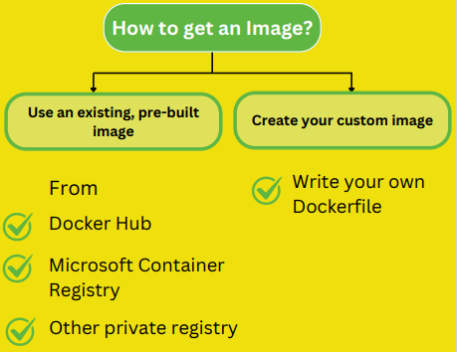
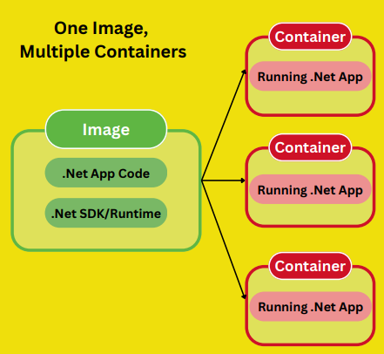

Slide 23
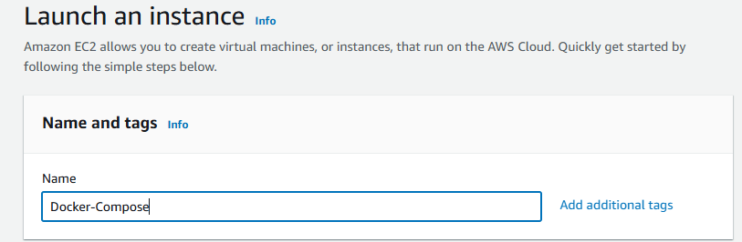
Create an EC2 Instance
Instance Name: Docker-Compose
AMI: Ubuntu 24.0
Instance Type: t2.micro
Security Group: Enable
HTTP
HTTPS
ALL TCP (0-65535)
Action: Launch the instance.

Slide 24
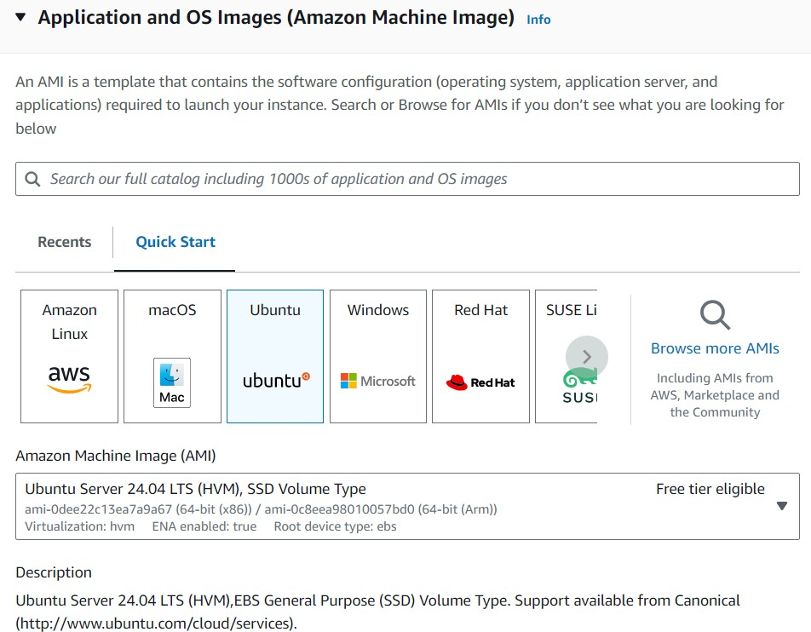
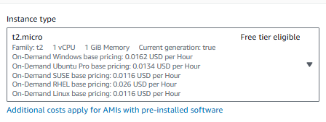
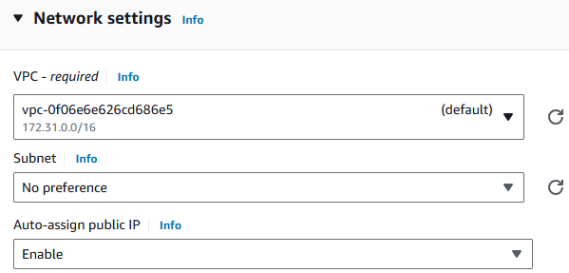
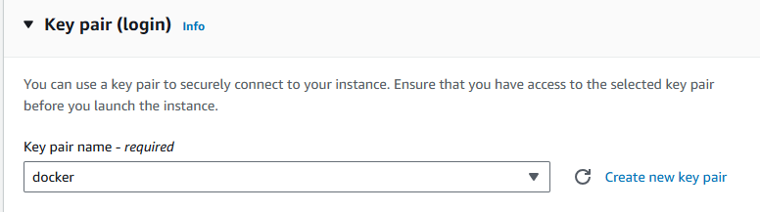

Slide 25
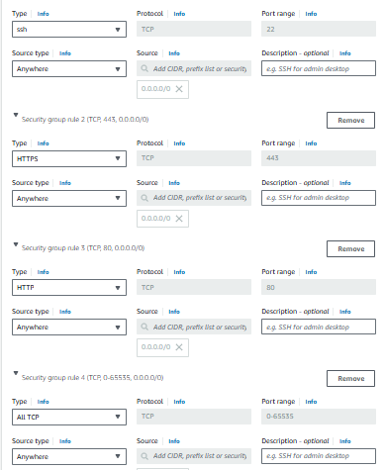
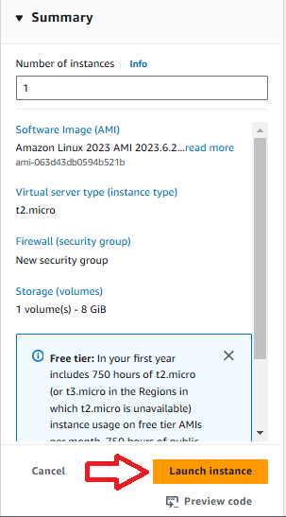

Slide 26
2. Connect to the EC2 Instance and Install Required Packages
Run the following commands in the terminal after connecting via SSH:
Step 1: Install Docker
Make sure Docker is installed on your machine. If not, follow the below commands.
# Update the package list
sudo apt-get update
#Upgrades the installed packages
sudo apt upgrade –y
#Dependencies Installation
sudo apt install apt-transport-https ca-certificates curl software-properties-common -y
#Docker signs its packages with a GPG key
curl -fsSL https://download.docker.com/linux/ubuntu/gpg | sudo gpg --dearmor -o /usr/share/keyrings/docker-archive-keyring.gpg
#To add the Docker repository to your system’s list of APT sources
echo "deb [arch=amd64 signed-by=/usr/share/keyrings/docker-archive-keyring.gpg] https://download.docker.com/linux/ubuntu $(lsb_release -cs) stable" | sudo tee /etc/apt/sources.list.d/docker.list > /dev/null

Slide 27
#Update APT Package
sudo apt update –y
#Install Docker’s engine, CLI, and container runtime
sudo apt install docker-ce docker-ce-cli containerd.io -y
#Starts the Docker service immediately
sudo systemctl start docker
#Ensures Docker starts
sudo systemctl enable docker
#Ensures Docker status
sudo systemctl status docker
#verifying its version
docker –version
# Adds your user to the docker group
sudo usermod -aG docker $USER
newgrp docker

Slide 28
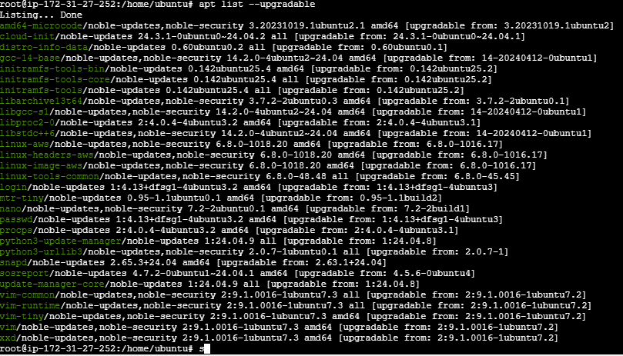

Slide 29
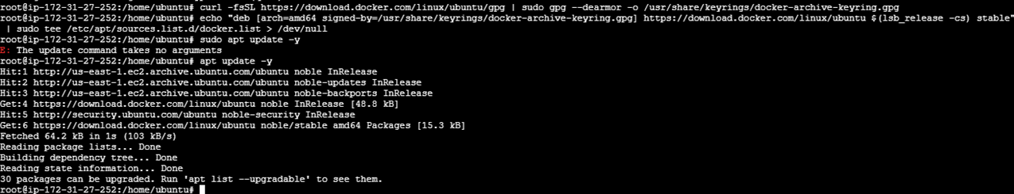
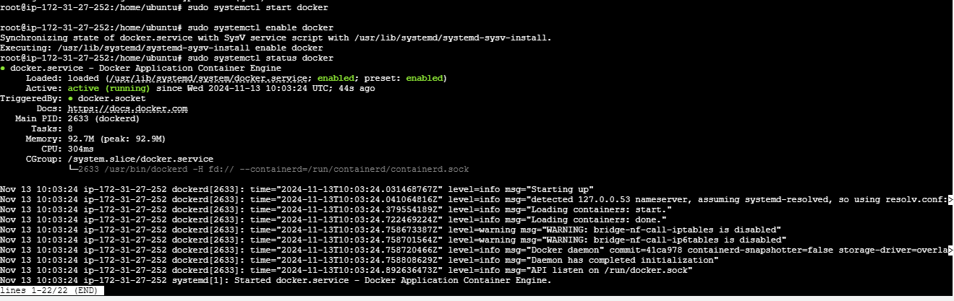
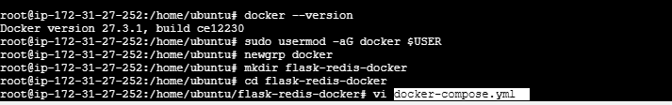

Slide 30
Docker Compose
Docker Compose is a tool that allows you to define and manage multi-container Docker applications using a simple YAML file called docker-compose.yml.
With Docker Compose, you can:
Define Services: Specify the various services that make up your application (e.g., web server, database, cache).
Configure Services: Set up how each service should run, including settings like ports, volumes, and environment variables.
Manage Multi-Container Applications: Use a single command to start and stop all services, simplifying the orchestration of complex applications.
Basic Commands:
docker-compose up: Starts the application and creates containers for each service defined in the docker-compose.yml .
docker-compose down: Stops and removes all containers defined in the docker-compose.yml.
docker-compose logs: Displays the logs from all containers in the application.

Slide 31
What is YAML?
YAML (YAML Ain’t Markup Language) is a human-readable data serialization language often used for configuration files. It is designed to be simple and easy to read, making it a popular choice for developers.
Key Features of YAML:
Human-Readable: Easy to read and write, making it suitable for configuration files.
Hierarchical Structure: Supports nested data structures, allowing for complex configurations
Data Serialization: Ideal for representing data structures such as lists and dictionaries.
File Extensions: YAML files typically have a .yml or .yaml extension.

Slide 32
We will create a project with :
A Flask application that serves a simple web page.
A Redis database that the Flask app will use for storing and retrieving data.
Docker Compose to orchestrate these services.
Step-by-Step Solution
Step 1: Set Up Project Directory
Here we have to install docker-compose by using below
command
sudo apt install docker-compose -y
Create a project directory:
mkdir flask-redis-docker
cd flask-redis-docker
Step 2: Create Docker Compose File
Create a docker-compose.yml file in the root directory:
Docker-compose.yml file
version: '3.8'
services:
web:
build:
context: ./web
ports:
- "5000:5000"
environment:
- REDIS_HOST=redis
depends_on:
- redis
redis:
image: redis:alpine
ports:
- "6379:6379"

Slide 33
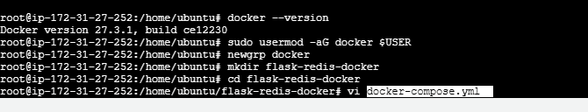
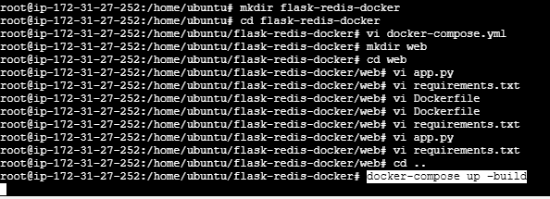
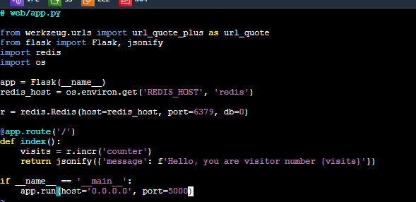

Slide 34
App.py file
# web/app.py
from werkzeug.urls import url_quote_plus as url_quote
from flask import Flask, jsonify
import redis
import os
app = Flask(__name__)
redis_host = os.environ.get('REDIS_HOST', 'redis')
r = redis.Redis(host=redis_host, port=6379, db=0)
@app.route('/')
def index():
visits = r.incr('counter')
return jsonify({'message': f'Hello Rekhasri, you are visitor number {visits}'})
if __name__ == '__main__':
app.run(host='0.0.0.0', port=5000)
Create subdirectories for the Flask app
mkdir web
cd web
Step 3: Create Flask Application
Create a file named app.py in the web directory

Slide 35
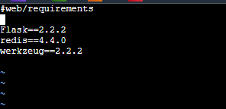
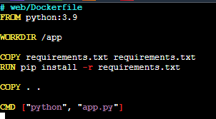
Dockerfile
# web/Dockerfile
FROM python:3.9
WORKDIR /app
COPY requirements.txt requirements.txt
RUN pip install -r requirements.txt
COPY . .
CMD ["python", "app.py"]
Create a requirements.txt file in the web directory
Requirements.txt file
Flask==2.2.2
redis==4.4.0
werkzeug==2.2.2
Step 4: Create a Dockerfile for Flask App
Create a Dockerfile in the web directory

Slide 36
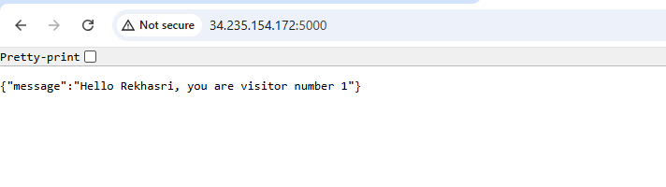
Step 5: Build and Run the Application
#Navigate to the root of the project directory
cd flask-redis-docker
#Run the following command to build and start the services
docker-compose up –build
Step 6: Access the Application
Open your web browser and go to
http://PublicIP:5000
You should see a JSON response like

Slide 37

Step 7: Manage the Containers
#To view the logs
docker-compose logs
#To start the containers again
docker-compose up
Step 8: Remove the Containers
#To remove all containers defined in the docker-compose.yml
docker-compose down

Slide 38


